Slide 1
Operations @ Python Strings

Slide 2
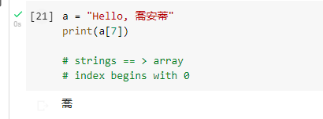
Strings are python are arrays of bytes representing Unicode characters.

Slide 3
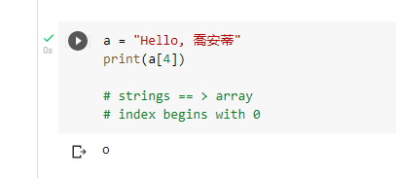
Strings are Arrays ==> acces the elemet of arrays
Python does not have a character data type, a single character is simply a string with a length of 1

Slide 4
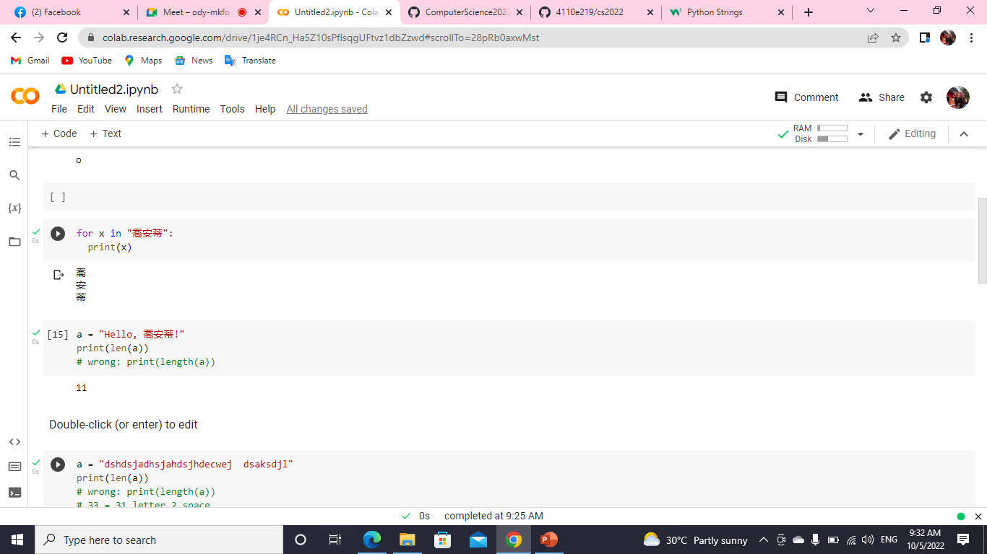
Looping Through a String

Slide 5

String Length: To get the length of a string, use the len ()function.

Slide 6
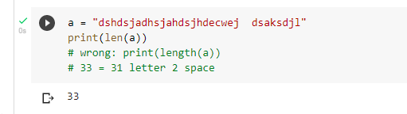
QUIZ:tell me how many char appear in "dshdsjadhsjahdsjhdecwej dsaksdjl“

Slide 7
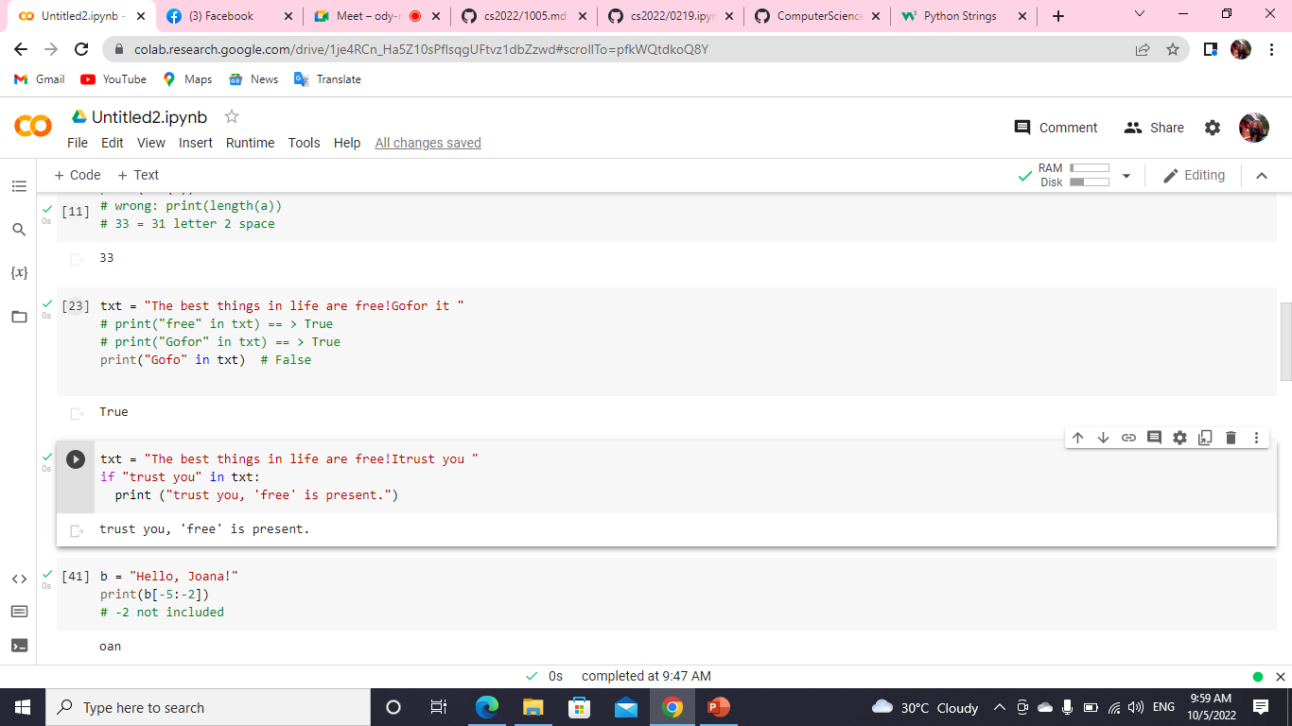
Check String: To check if a certain phrase or character is present in a string,
we can use the keyword in .
keyword in vs if
True or False

Slide 8
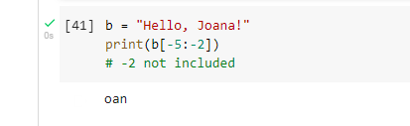
Negative Indexing

Slide 9
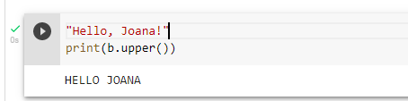
Python - Modify Strings
The upper() method returns the string in upper case:
The lower() method returns the string in lower case

Slide 10
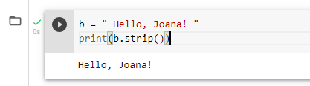
Remove Whitespace with strip() method
The strip() method removes any whitespace from the beginning or the end

Slide 11

The replace()method replaces a string with another string
seperator

Slide 12
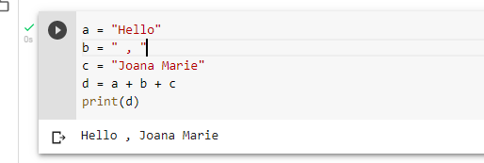
String Concatenation: To concatenate, or combine, two strings you can use the `+` operator.

Slide 13
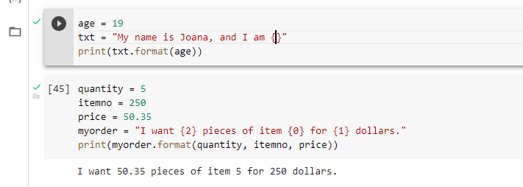
Python - Format - Strings

Slide 14
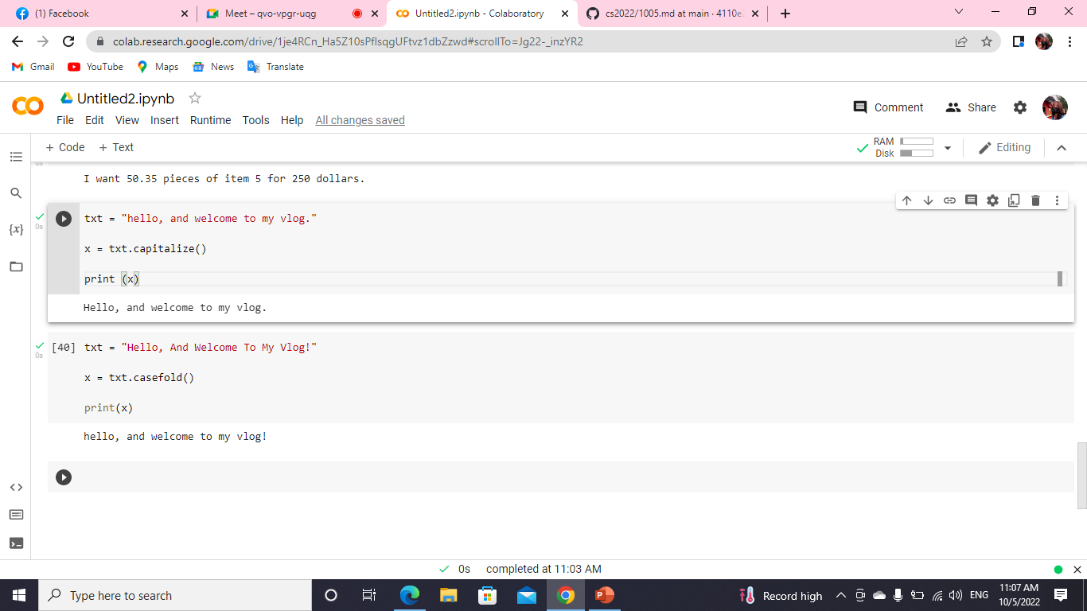
String Methods

Slide 15
Thank you!

